Slide 1
Topics of this course
What is CS ?
Lect 1: what is computer
Lect 2: how is computer system working
Lect 3: Turing machine & P vs NP
Lect 4: computational thinking & algorithm
Lect 5: cloud computing
Why is CS so hot ?
Lect 6: introduction to machine learning and AI
Lect 7: introduction to big data
Lect 8: introduction to alphaFold/alphaFold2
How to learn CS ?

Slide 2
Intro to AlphaFold2
qiang@suda.edu.cn

Slide 3
What does AlphaFold do?
解决根据氨基酸序列预测蛋白质3D结构
AlphaGo/Zero之后的第二次出手
又一次轰动！
把蛋白质3D结构预测问题科普到了公众面前

Slide 4
什么是蛋白质3D结构预测(1)
士兵 –> 原子 （CHON四个兵种）
班 –> 氨基酸 （20种班）
班班一棒相连 –> 残基肽键相连
连：若干相连的班 –> 二级结构
营：若干连 -> 域（基本功能）
团：若干营（每个士兵3D位置） -> 蛋白质3D结构（相对完整功能）
班序列 -> 蛋白质一级结构

Slide 5
什么是蛋白质3D结构预测（2）
给定一个班序列，找出团最佳士兵3D布置
给定一个氨基酸序列，找出蛋白质每个原子的3D位置
“蛋白质的高级空间结构由蛋白质的氨基酸序列决定”（ Anfinsen，1972，诺贝尔化学奖）
利用领域约束降低自由度，降低难度：
2D简化结构，HP模型，NP-C问题
“这不但是生物信息学，也是整个生物学中的一个重要的‘圣杯’。”

Slide 6
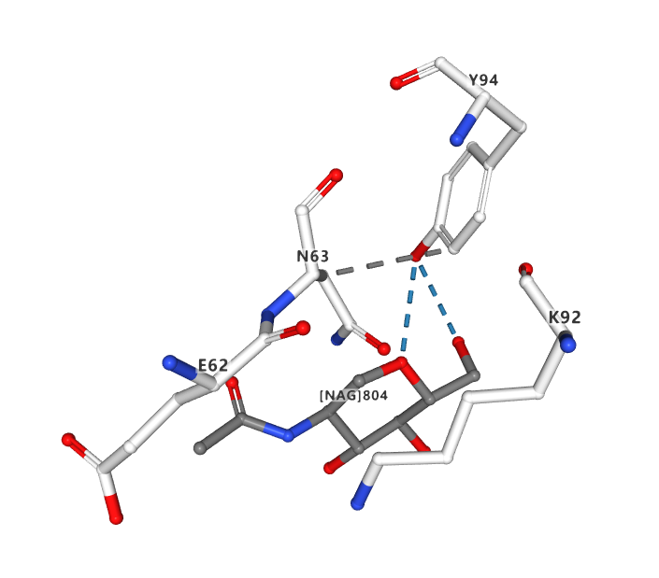
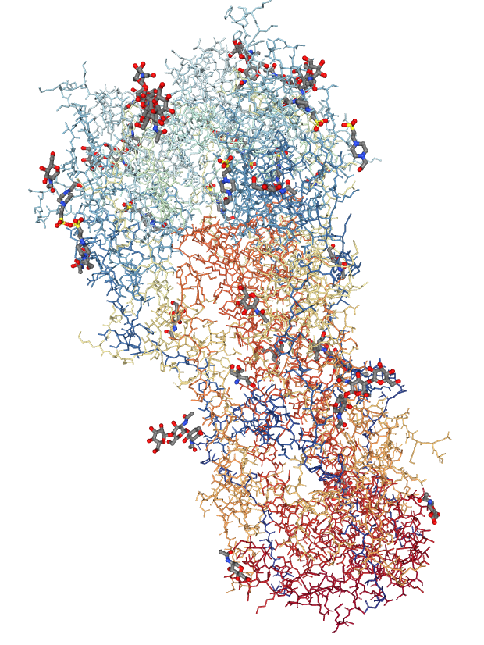
例：H3N2猪流感病毒

Slide 8
N | SER | 1 | -8.386 | -14.613 | 15.694
CA | SER | 1 | -9.074 | -13.914 | 16.818
C | SER | 1 | -8.375 | -14.155 | 18.157
O | SER | 1 | -7.518 | -15.044 | 18.279
CB | SER | 1 | -10.549 | -14.336 | 16.903
OG | SER | 1 | -10.681 | -15.684 | 17.324
1H | SER | 1 | -8.873 | -14.431 | 14.84
2H | SER | 1 | -7.446 | -14.28 | 15.619
3H | SER | 1 | -8.378 | -15.598 | 15.868
HA | SER | 1 | -9.032 | -12.839 | 16.635
1HB | SER | 1 | -11.074 | -13.686 | 17.602
2HB | SER | 1 | -11.019 | -14.214 | 15.928
HG | SER | 1 | -9.787 | -16.009 | 17.456
N | THR | 2 | -8.756 | -13.346 | 19.148
CA | THR | 2 | -8.28 | -13.455 | 20.529
C | THR | 2 | -8.575 | -14.822 | 21.17
O | THR | 2 | -7.736 | -15.377 | 21.887
CB | THR | 2 | -8.881 | -12.286 | 21.364
OG1 | THR | 2 | -7.943 | -11.205 | 21.411
CG2 | THR | 2 | -9.045 | -12.654 | 22.835
H | THR | 2 | -9.415 | -12.618 | 18.911
HA | THR | 2 | -7.193 | -13.377 | 20.527
HB | THR | 2 | -9.86 | -12.021 | 20.966
HG1 | THR | 2 | -7.155 | -11.444 | 20.917
1HG2 | THR | 2 | -9.468 | -11.808 | 23.377
2HG2 | THR | 2 | -9.712 | -13.512 | 22.923
3HG2 | THR | 2 | -8.073 | -12.906 | 23.257
N | LYS | 3 | -9.76 | -15.362 | 20.892
CA | LYS | 3 | -10.216 | -16.616 | 21.495
C | LYS | 3 | -9.44 | -17.838 | 21.006
O | LYS | 3 | -9.219 | -18.784 | 21.768
CB | LYS | 3 | -11.722 | -16.797 | 21.267
CG | LYS | 3 | -12.466 | -17.44 | 22.447
CD | LYS | 3 | -12.152 | -16.768 | 23.808
CE | LYS | 3 | -12.683 | -15.331 | 23.916
NZ | LYS | 3 | -14.166 | -15.271 | 24.068
H | LYS | 3 | -10.363 | -14.882 | 20.239
HA | LYS | 3 | -10.026 | -16.573 | 22.568
1HB | LYS | 3 | -12.179 | -15.827 | 21.07
2HB | LYS | 3 | -11.885 | -17.42 | 20.388
1HG | LYS | 3 | -13.542 | -17.374 | 22.279
2HG | LYS | 3 | -12.192 | -18.492 | 22.52
1HD | LYS | 3 | -12.598 | -17.352 | 24.614
2HD | LYS | 3 | -11.073 | -16.738 | 23.959
1HE | LYS | 3 | -12.23 | -14.84 | 24.776
2HE | LYS | 3 | -12.408 | -14.773 | 23.021
1HZ | LYS | 3 | -14.46 | -14.307 | 24.134
2HZ | LYS | 3 | -14.605 | -15.702 | 23.267
3HZ | LYS | 3 | -14.439 | -15.763 | 24.906

Slide 9
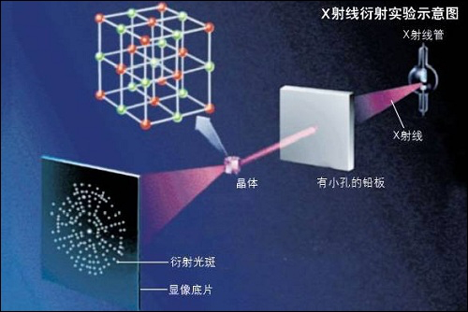
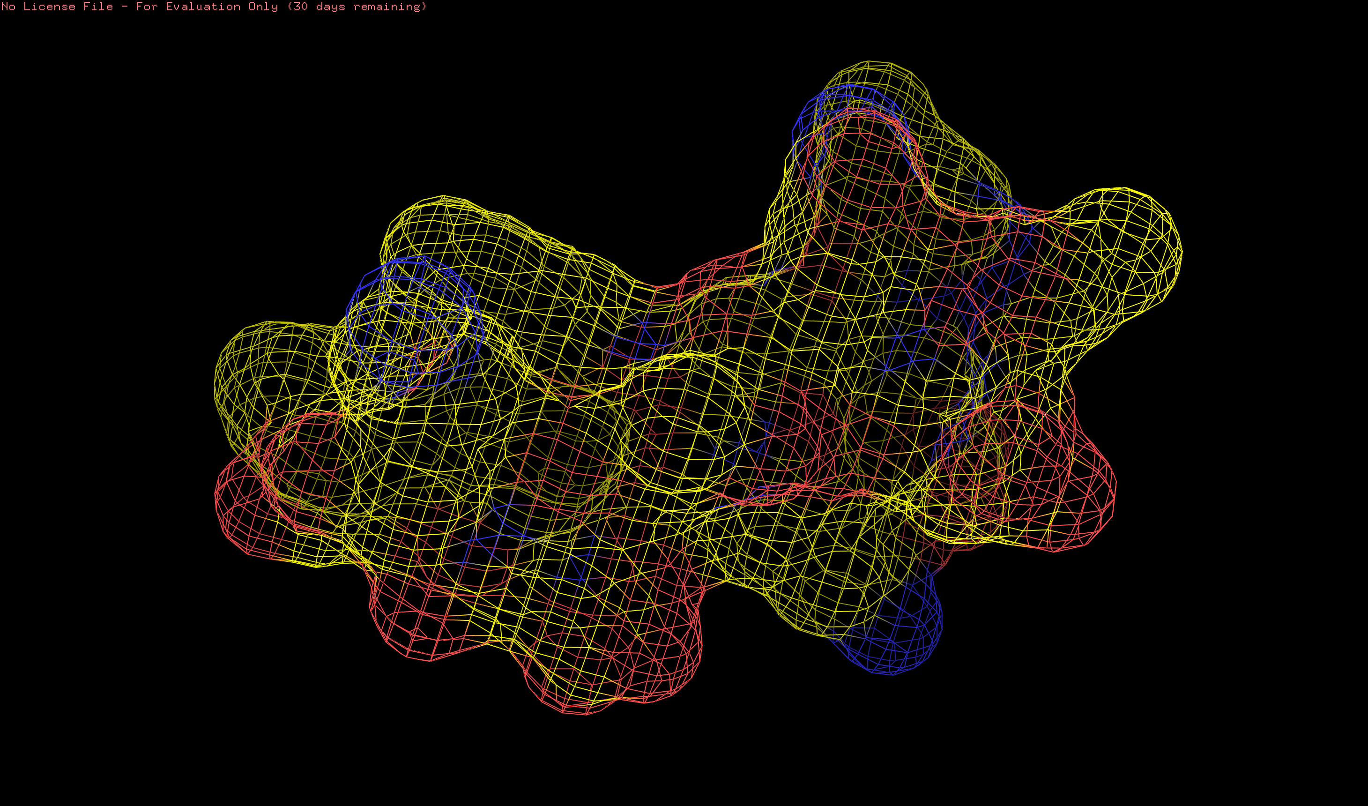
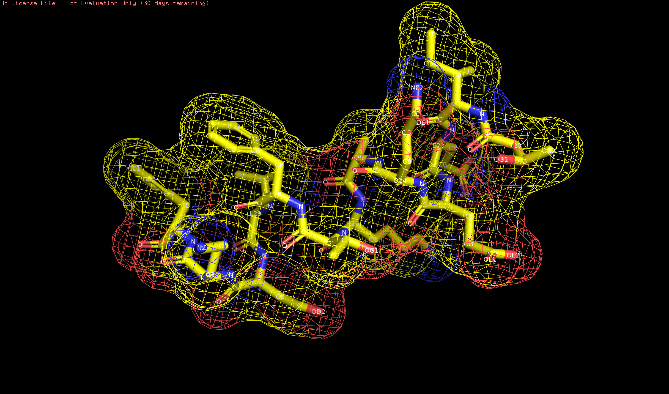
实验测定protein 3D structure
XRC
cryo-EM

Slide 10
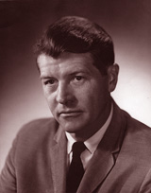
PSP可行性
Christian B. Anfinsen
for his work on ribonuclease, especially concerning the connection between the amino acid sequence and the biologically active conformation
Nobel Prize in Chemistry 1972

Slide 11
PSP的一般思路
第一性原理，MD
TBM
FM

Slide 12
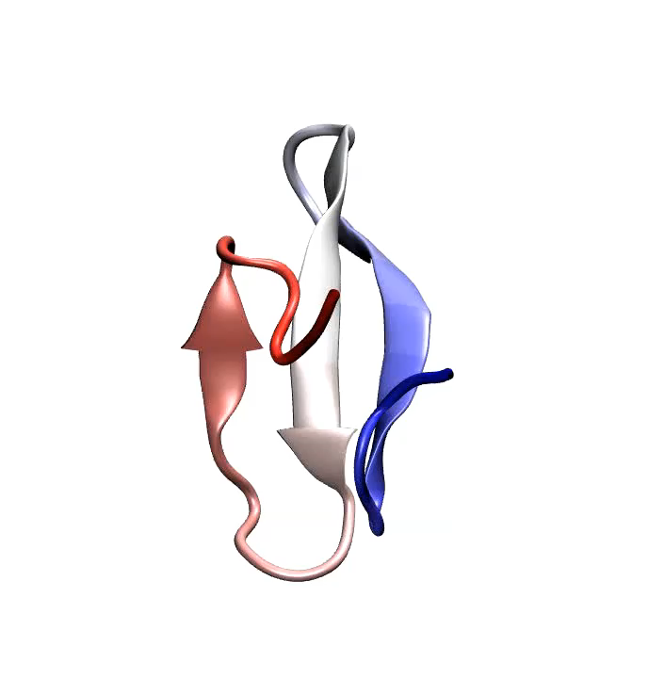
How residue chain folds into 3D structure: MD solution

Slide 13
TBM
Family members look like similarly
Employing family members which have known structures

Slide 14
FM

Slide 15
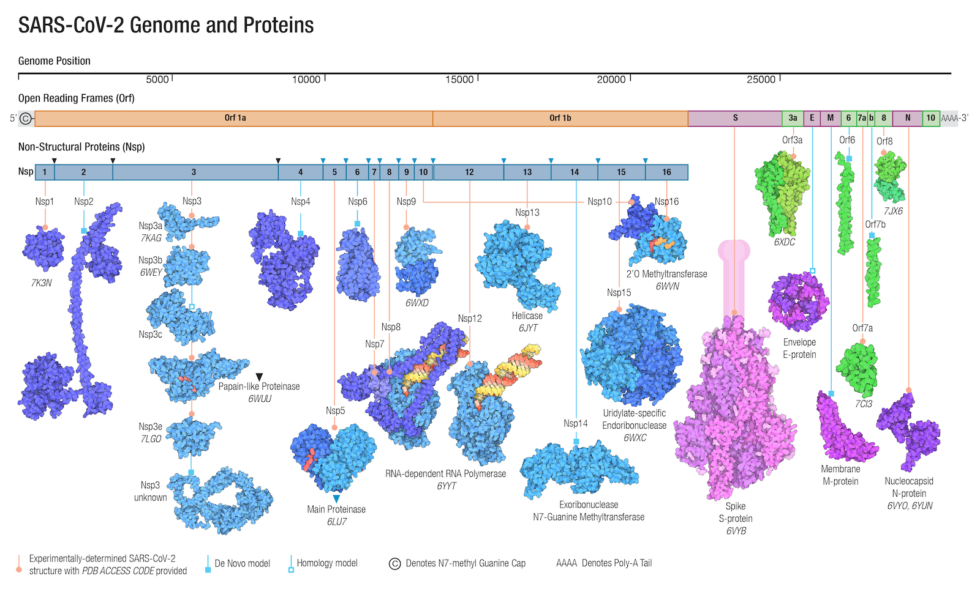

Slide 16
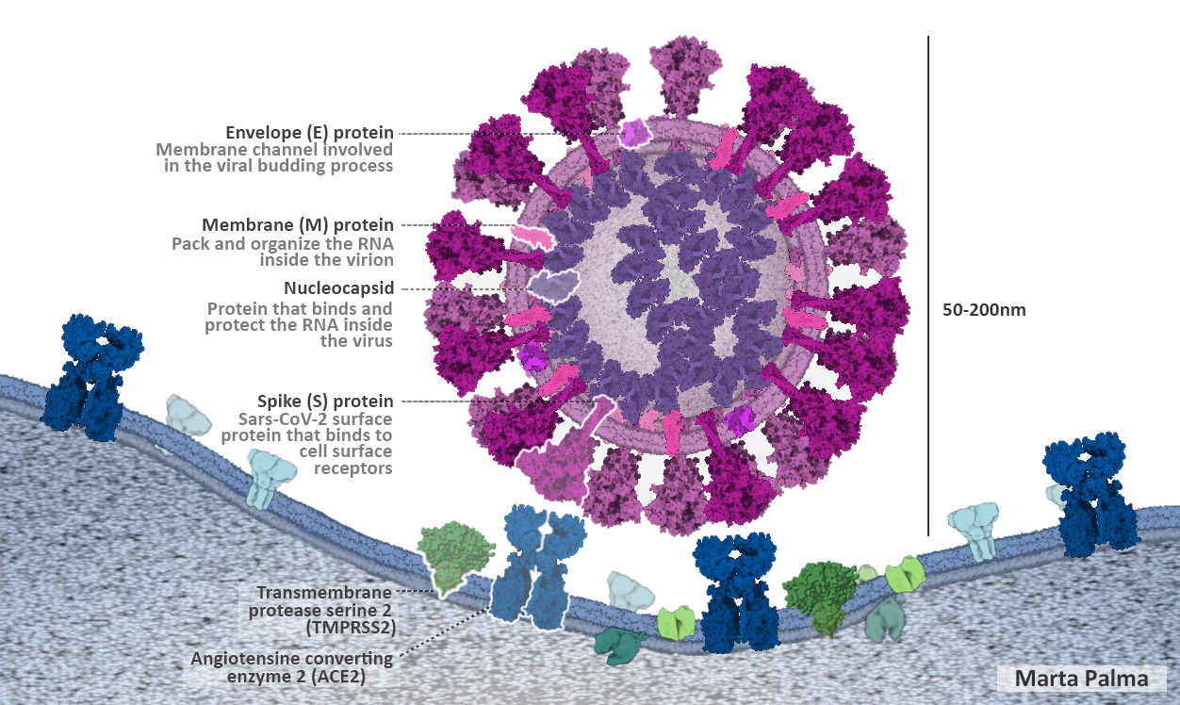

Slide 17
Papers published
1: Senior AW, Improved protein structure prediction using potentials from deep learning. Nature. 2020 Jan;577(7792):706-710. (AlphaFold)
2: Jumper J, Highly accurate protein structure prediction with AlphaFold. Nature. 2021 Aug;596(7873):583-589. (AlphaFold2)
3: Tunyasuvunakool K, Highly accurate protein structure prediction for the human proteome. Nature. 2021 Aug;596(7873):590-596.

Slide 18
Intro to CASP
Critical Assessment Of Structure Prediction
Since 1994, biennial
Unified evaluation with acknowledgement

Slide 19
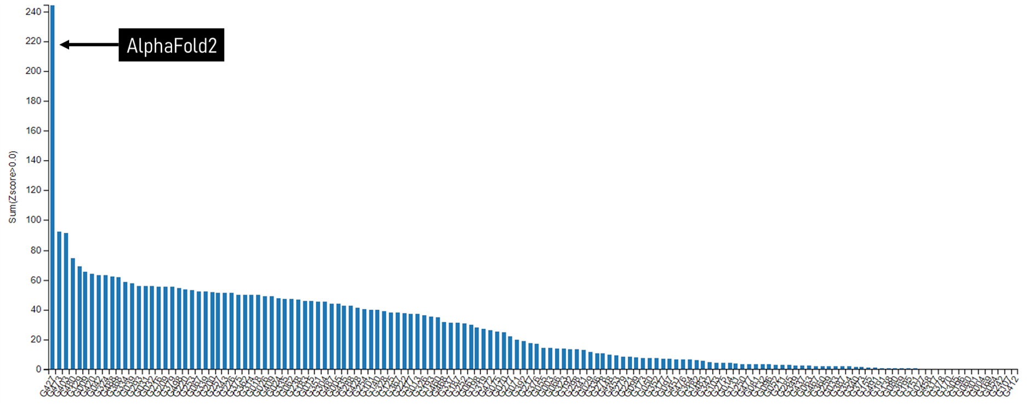
How good is AF2 in CASP14

Slide 20
Impact from AF2
Before AF2, 实验科学家证实预测结果
After AF2
实验科学家证伪预测结果
AI进入传统科学领域

Slide 21
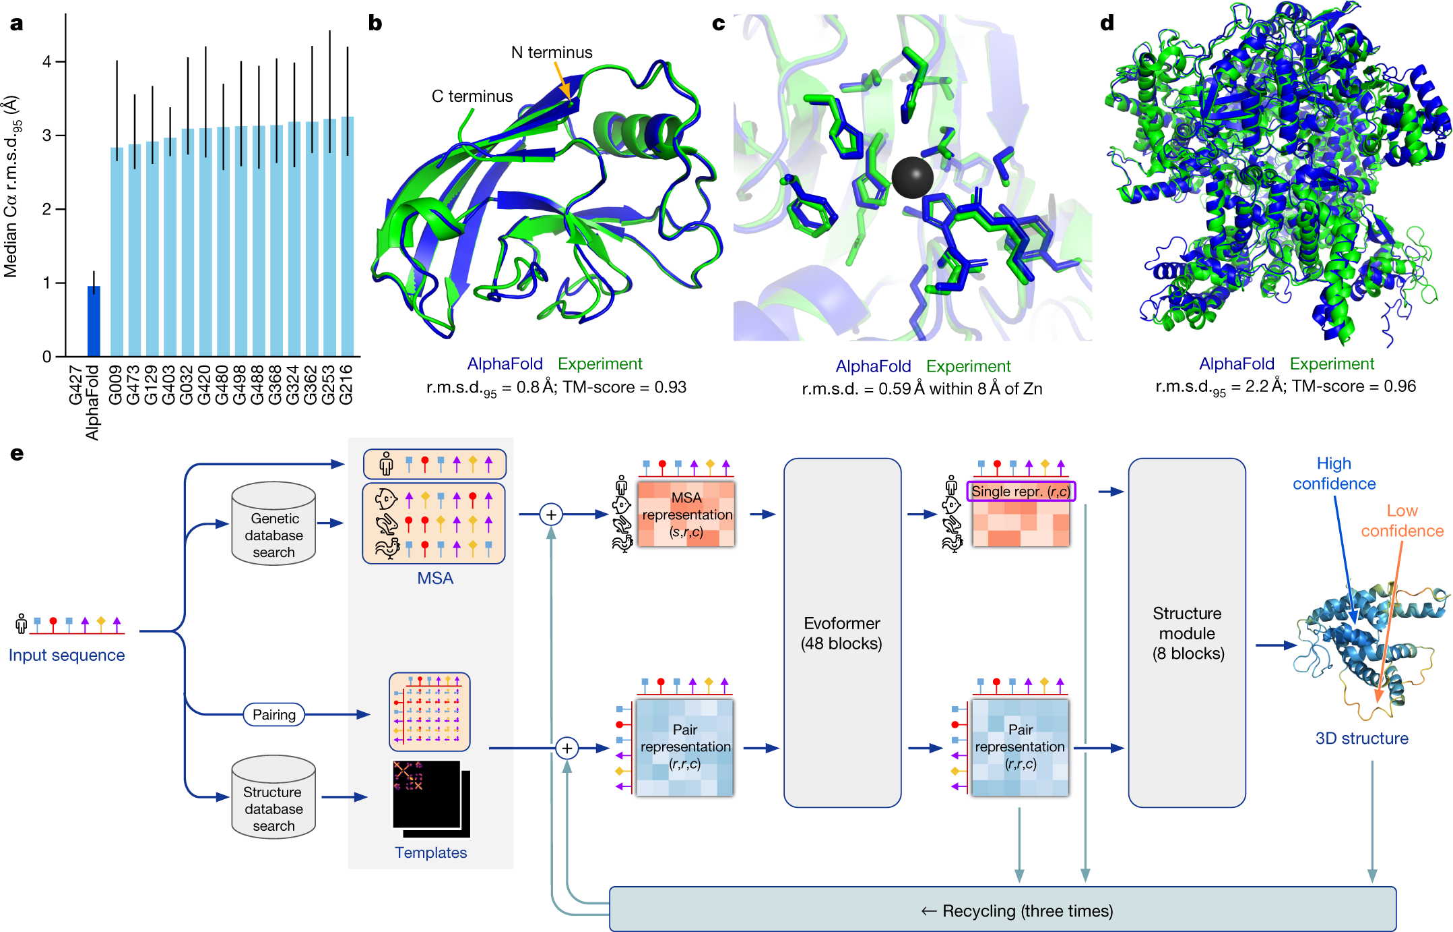
Notes:
a, The performance of AlphaFold on the CASP14 dataset (n = 87 protein domains) relative to the top-15 entries (out of 146 entries), group numbers correspond to the numbers assigned to entrants by CASP. Data are median and the 95% confidence interval of the median, estimated from 10,000 bootstrap samples. b, Our prediction of CASP14 target T1049 (PDB 6Y4F, blue) compared with the true (experimental) structure (green). Four residues in the C terminus of the crystal structure are B-factor outliers and are not depicted. c, CASP14 target T1056 (PDB 6YJ1). An example of a well-predicted zinc-binding site (AlphaFold has accurate side chains even though it does not explicitly predict the zinc ion). d, CASP target T1044 (PDB 6VR4)—a 2,180-residue single chain—was predicted with correct domain packing (the prediction was made after CASP using AlphaFold without intervention). e, Model architecture. Arrows show the information flow among the various components described in this paper. Array shapes are shown in parentheses with s, number of sequences (N_{seq} in the main text); r, number of residues (N_{res} in the main text); c, number of channels.

Slide 22
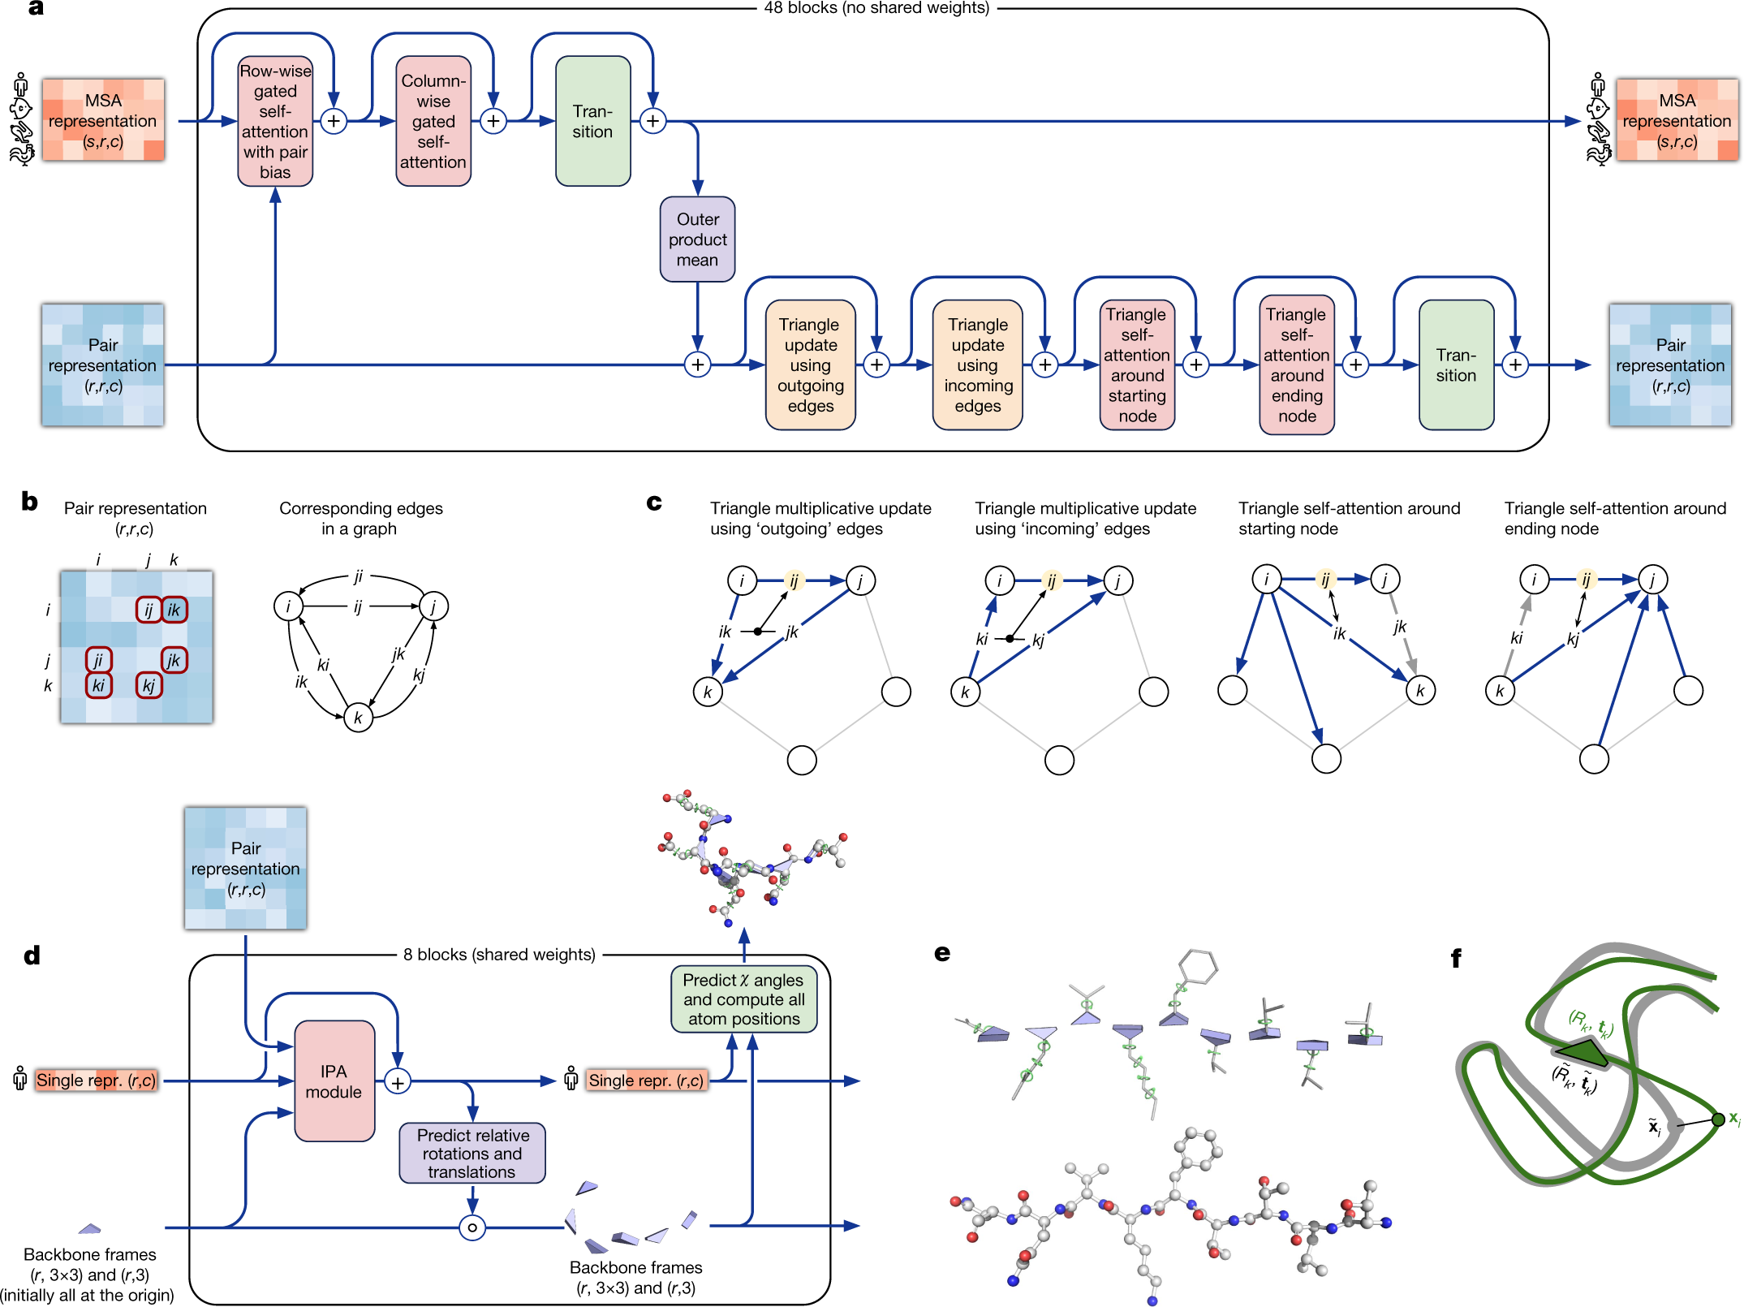
Notes:
a, Evoformer block. Arrows show the information flow. The shape of the arrays is shown in parentheses. b, The pair representation interpreted as directed edges in a graph. c, Triangle multiplicative update and triangle self-attention. The circles represent residues. Entries in the pair representation are illustrated as directed edges and in each diagram, the edge being updated is ij. d, Structure module including Invariant point attention (IPA) module. The single representation is a copy of the first row of the MSA representation. e, Residue gas: a representation of each residue as one free-floating rigid body for the backbone (blue triangles) and χ angles for the side chains (green circles). The corresponding atomic structure is shown below. f, Frame aligned point error (FAPE). Green, predicted structure; grey, true structure; (R_{k,} t_{k}), frames; x_{i}, atom positions.

Slide 23
Homework 8: 为核酸检测新冠找靶点
可以把Covid-19病毒的遗传物质RNA看作一个30000字符长的一个串C。假设已知的病毒库V中有超过n条长度类似的DNA/RNA串。要求在C中找到最少个数的子字符串s1,s2,…sn，这些子字符串的长度尽量短，使得(s1,s2,…sn)在V中没有任何串同时含有这些子字符串。于是这些s1,s2,…sn就可以是检测新冠的靶点了。
给出你的计算解决方案。

